Slide 1



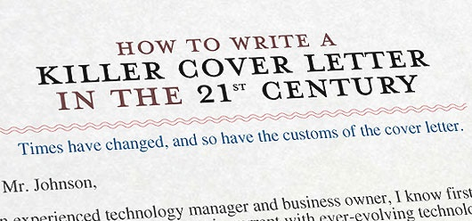
Writing a Cover Letter
Good Practices & Common Mistakes
Svetlin Nakov
Technical Trainer
www.nakov.com
Software University
http://softuni.bg

Slide 2



Secrets of Successful Cover Letter
Be unique
Demonstrate motivation!
Explain why you have the skills
Write what the employer wants!
Match the requirements
Use your own words!
Good design / layout

Slide 3

Table of Contents
Why We Need a Cover Letter?
Template-Based Cover Letters
How to Write a Good Cover Letter?
Lying in the Cover Letter?
Don’t Make Mistakes!
Good and Bad Cover Letters Live Examples

Slide 4

Why Do We Need a Cover Letter?

Slide 5
What is the Cover Letter?
The cover letter (CL) is a way of:
Introducing yourself to a potential employer
Explaining why you are suitable for the position
Employers look for individualized and thoughtfully written cover letters
You put time writing CL → you are serious
This is a method of screening out applicants who
Are not sufficiently interested in their position
Who lack necessary basic skills

Slide 6

What is the Cover Letter? (2)
Cover letters can be:
The application letter or invited cover letter
Responds to a known job opening
The prospecting letter or uninvited cover letter
Inquires about possible positions

Slide 7

Why We Need a Cover Letter?
The cover letter is the best way to show how motivated you are
Also known as letter of motivation
Why you want to start a career in this particular company?
Why at exactly this position?
Why at exactly this team?
Why you have the skills?
Do you have arguments?
Etc.
Need?

Slide 8
Companies Requesting Cover Letters
Some people think that nobody reads the cover letters
Consider them a meaningless requirement
Such people believe that strong CV and rich experience is enough
In some companies this could be true
In best employers this is great mistake
If a cover letter is requested
Be sure it will be read
At least at a glance
Cover Letter?

Slide 9
What We Gain from Cover Letter?
In the most prestigious and well-structured companies the cover letter is very important
The human resources (HR) team at the company definitely reads it
If the cover letter is impressive
You will be immediately contacted and invited to an interview
Even if your experience is not great
Impressive cover letter opens doors!
Value!

Slide 10
Cover Letters: Remember
It is always worth to send a well-prepared and impressive cover letter
Unique, especially written for exactly this company and exactly this job position
Never "reuse" your cover letters!
A great cover letter for certain company and job position is bad for another company / position
Uniqueness!

Slide 11
Cover Letters: Beware
If you apply for a second time in given company
Be sure to rewrite your cover letter
Most good companies will disregard your application when you reuse the cover letter
The same cover letter means that
Your motivation has not changed
Your qualification is not changed
They should reject you again
Never reuse CL!

Slide 12


Recruiters Will Research You!
Be sure that the HR professionals will try to find all the information about you they can
They will search in Google about you
They will try to find your Facebook profile
They will try to find information about you from current/past employers
Research

Slide 13

The HR Will Research You (2)
The HR professionals never forget if you had ever sent a bad job application
They will find you, be sure!
That’s why you should always carefully prepare your job application before sending it
Think a bit how to proceed the next time when you apply for a job
Bad Application?

Slide 14
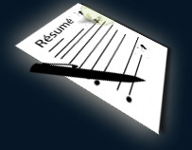
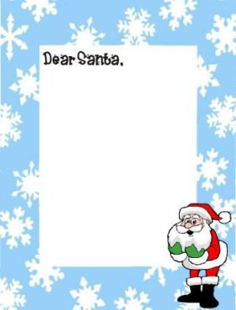
Template-Based Cover Letters
Cover
Letter
Template

Slide 15

Template-Based Cover Letters
The best way to guarantee a failure when applying for a job is
To use a template-based cover letter
Don't copy / paste!
Once we received a really "nice" cover letter:
Bad idea!
“Dear Employer, I would like to apply for Your Company because I am skillful and highly enthusiastic candidate. I want to grow in Your Company, to improve my knowledge and skills. Your company is the best and I want to be part of it. I am hard worker and I am sure I will help your business to grow.”

Slide 16
Template-Based Cover Letters (2)
Phrases like “Your Company” are always evil!
When you copy / paste the cover letter
You say nothing about why you want exactly this position in exactly this company
How your experience in the past will help you do exactly this job
Why you really match the requirements from the job offer
Once we received a cover letter starting with “Dear …” (with dots left from the template!)
Bad idea!

Slide 17

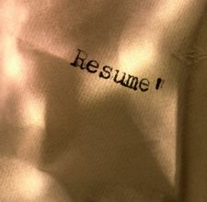


How to Write a Good Cover Letter?
Good CL?

Slide 18

A Good Cover Letter
A good cover letter:
Shows that you apply exactly for this company, not some other
You want this particular company and this particular position
Not just looking for some job
Shows you have a clear idea of the position
What your future responsibilities will be, etc.
Your skills match the requirements
You have great motivation for this job
Good CL

Slide 19
What is a Good Cover Letter?
Good cover letter writers first carefully read
About the offered position
The detailed job description
The requirements stated in the job offer
About the company
Hint: write 1-2 sentences for each requirement
Not directly following the job description
Not exactly in the order as in the job offer
Not exactly with the same words and phrases
Good CL

Slide 20
Example Job Offer Requirement
examine and analyze the technical documentation of competitors
You could write for example:
Don’t copy / paste this sentence, say it with your words!
If you don’t have similar experience, say for example:
Matching the Requirements
In my previous job I had to read a lot of technical documentation and thus I believe that I will be able to find, read and analyze various types of articles, documents, manuals, etc.
I like to read blogs and articles and I know that technical documentation is different but it should also be interesting and challenging.

Slide 21
Example Job Offer Requirement (2)
It is a bad idea to write:
How you prove this?
What are your arguments?
If you are not good in something → just skip writing about it
You can’t say you are good at something without any arguments
How you know you are good in this
Just describe it
I am very good in examining and analyzing the technical documentation of competitors.
Bad idea!

Slide 22

Matching the Requirements
Given the following requirement:
You could write something like:
The above could never be used as a template!
It depends on your past experience, interests, skills, personal character qualities, etc.
excellent communication skills
I believe I have a sense of communication because I had organized a large technical conference at the university where I needed to contact the speakers, arrange the venue, invite the attendees, attract sponsors, process the feedback, etc.

Slide 23
Bad Ideas
Example of a bad way to directly match requirements:
Similar nonsense claim is:
Saying something without arguments is always a bad idea
Either argument well your statement or just don’t talk about it
I have excellent communication skills.
Bad idea!
I am 18 years old and I have very rich experience in professional project management in large teams.

Slide 24
Who to Address in the Cover Letter?
This is a common question
Try to research who will be reading your cover letter
That way you can address him directly
Beware: never misspell the name, e.g.
If you don't know the exact person
Write "Dear Manager", "Mr./Mrs.", "HR Manager", etc.
Something more common
Addressing?
Dear Svetlin Nikolov and Training staff,

Slide 25


Lying in the Cover Letter?
Do You Really Need It?
Lying?

Slide 26
Lying in Cover Letter
Never lie!
Example:
If you lie in your CV or cover letter
You will be caught at the interview and you will get fired
Write in the cover letter something
Matching the requested requirements
Supported by true, valid arguments
Bad idea!
I have 5 years of experience with Swift.
Never lie!

Slide 27
Validate Your Arguments
You could prove that you match certain requirements either
By showing similar experience
By saying you have read about this in the past
By sharing that you have a friend who always talks to you about this and have show it to you
You explain you want to learn this, you had read an article and watched a video tutorial
Always use valid arguments and never lie
If you say you are …, find supporting arguments
Valid arguments

Slide 28
Validate Your Arguments (2)
Another example:
How you prove this?
You could say that
or better explain that
Use valid arguments based on past experience
Not only work experience, but general
I am a hard-worker
… at the university I always had high grades because I always have come very well prepared for the exams, after very hard studying …
… when an important work is waiting, I cannot sleep until I get it done …

Slide 29



Don’t Make Mistakes!
Spelling / Punctuation / Formatting Mistakes
Mistakes

Slide 30

Avoid Mistakes
When writing your CV and cover letter, use a spell checker
Don’t make spelling mistakes, punctuation mistakes, etc.
MS Word / Google Docs / OpenOffice have very good spell checkers
Just use them!
Ask your friends to proof-read your CL
Spell Checker

Slide 31

Formatting Mistakes
Format your CV and cover letter well
At this point you can use templates
Just type "sample cover letter" in Google and you will find examples
Be sure to use only the styles, layout and formatting from the best examples you find
Never use the text inside
Some employers use an automated software to check for template-based cover letters
Be sure to write it entirely in your words
Nice Formatting!

Slide 32


Good and Bad Cover Letters
Live Demo
Good
Bad

Slide 33
Writing a Cover Letter
https://softuni.bg/courses/teamwork-and-personal-skills/

Slide 34
License
This course (slides, examples, demos, videos, homework, etc.) is licensed under the "Creative Commons Attribution-NonCommercial-ShareAlike 4.0 International" license

Slide 35





Free Trainings @ Software University
Software University Foundation – softuni.org
Software University – High-Quality Education, Profession and Job for Software Developers
softuni.bg
Software University @ Facebook
facebook.com/SoftwareUniversity
Software University @ YouTube
youtube.com/SoftwareUniversity
Software University Forums – forum.softuni.bg

